Slide 1

Smart Harbor Inventory System
A full-stack web application demonstrating end-to-end harbor inventory management with Dockerized deployment and modern DevOps practices

Slide 2
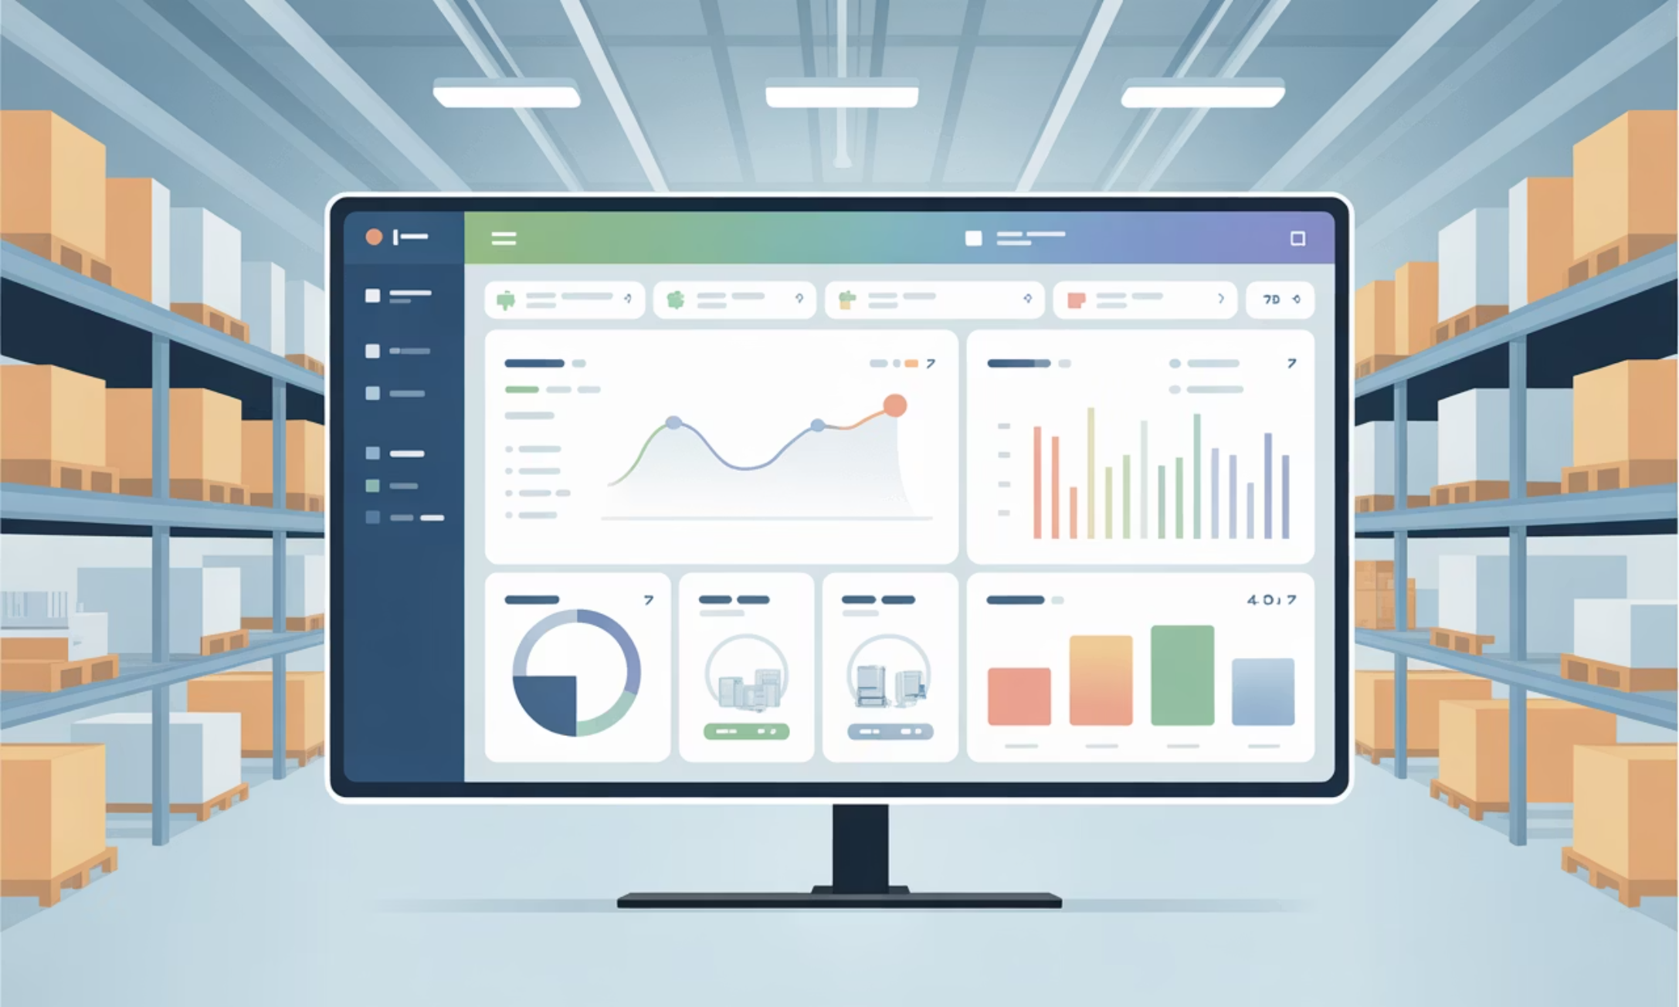
Project Overview
Comprehensive Solution
This project implements a complete harbor inventory management system featuring both frontend and backend components. The application enables efficient tracking and management of harbor goods through a responsive user interface that communicates with RESTful APIs.
Containerized using Docker for consistent deployment across environments, with frontend hosted on Vercel for global accessibility.

Slide 3

Technology Stack
Frontend
Backend
DevOps Tools
Vite + React framework
HTML, CSS, JavaScript
Axios for API calls
Environment variables
Vercel deployment
Spring Boot (Java)
RESTful APIs
JPA/Hibernate ORM
application.yml config
Port 8081 (container 8080)
Docker containerization
GitHub repository
SonarQube analysis
CI/CD pipeline
Quality gates

Slide 4
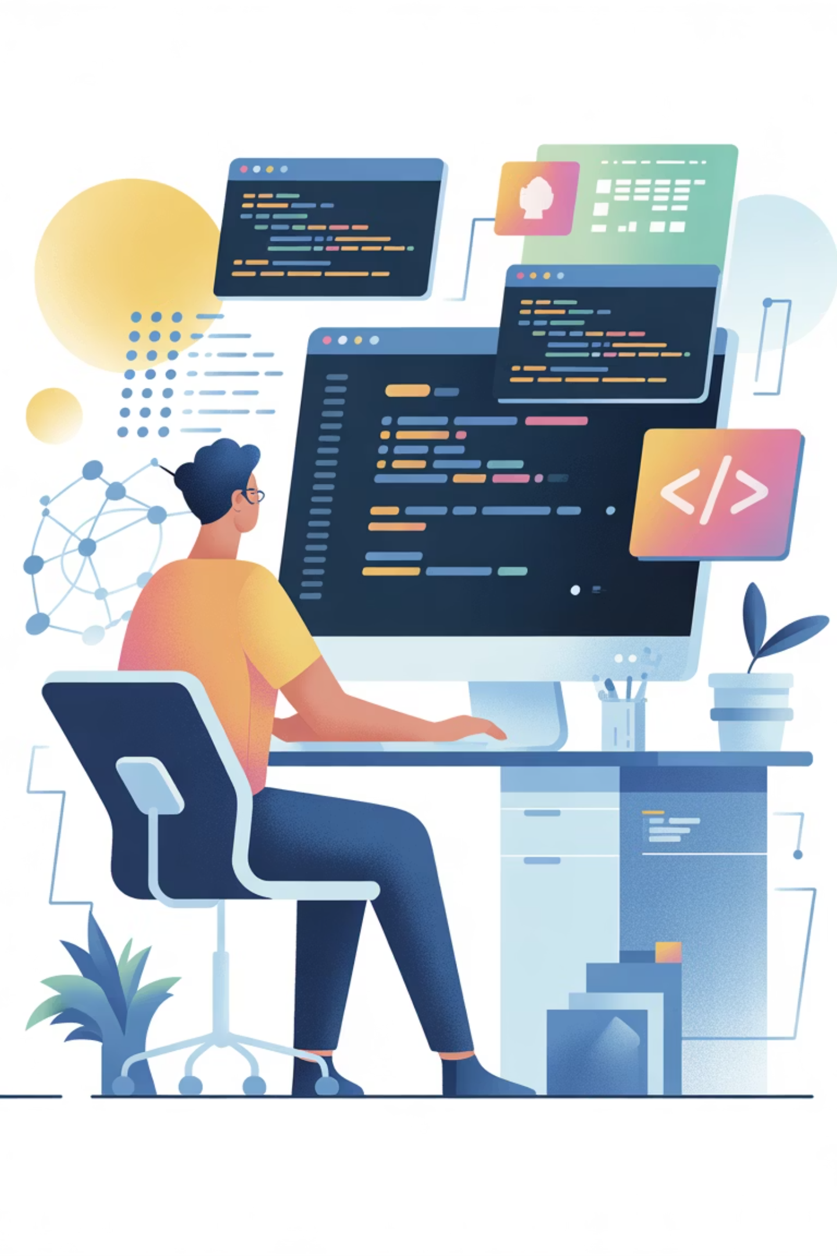
Core Features Implemented
Inventory Tracking
Comprehensive harbor goods management with real-time updates and tracking capabilities
REST API Integration
Backend endpoints for all inventory operations with proper request/response handling
Environment Configuration
Dynamic API base URL handling for seamless transitions between local development and production
Containerized Deployment
Docker-based backend services ensuring consistent runtime environment across all deployments

Slide 5
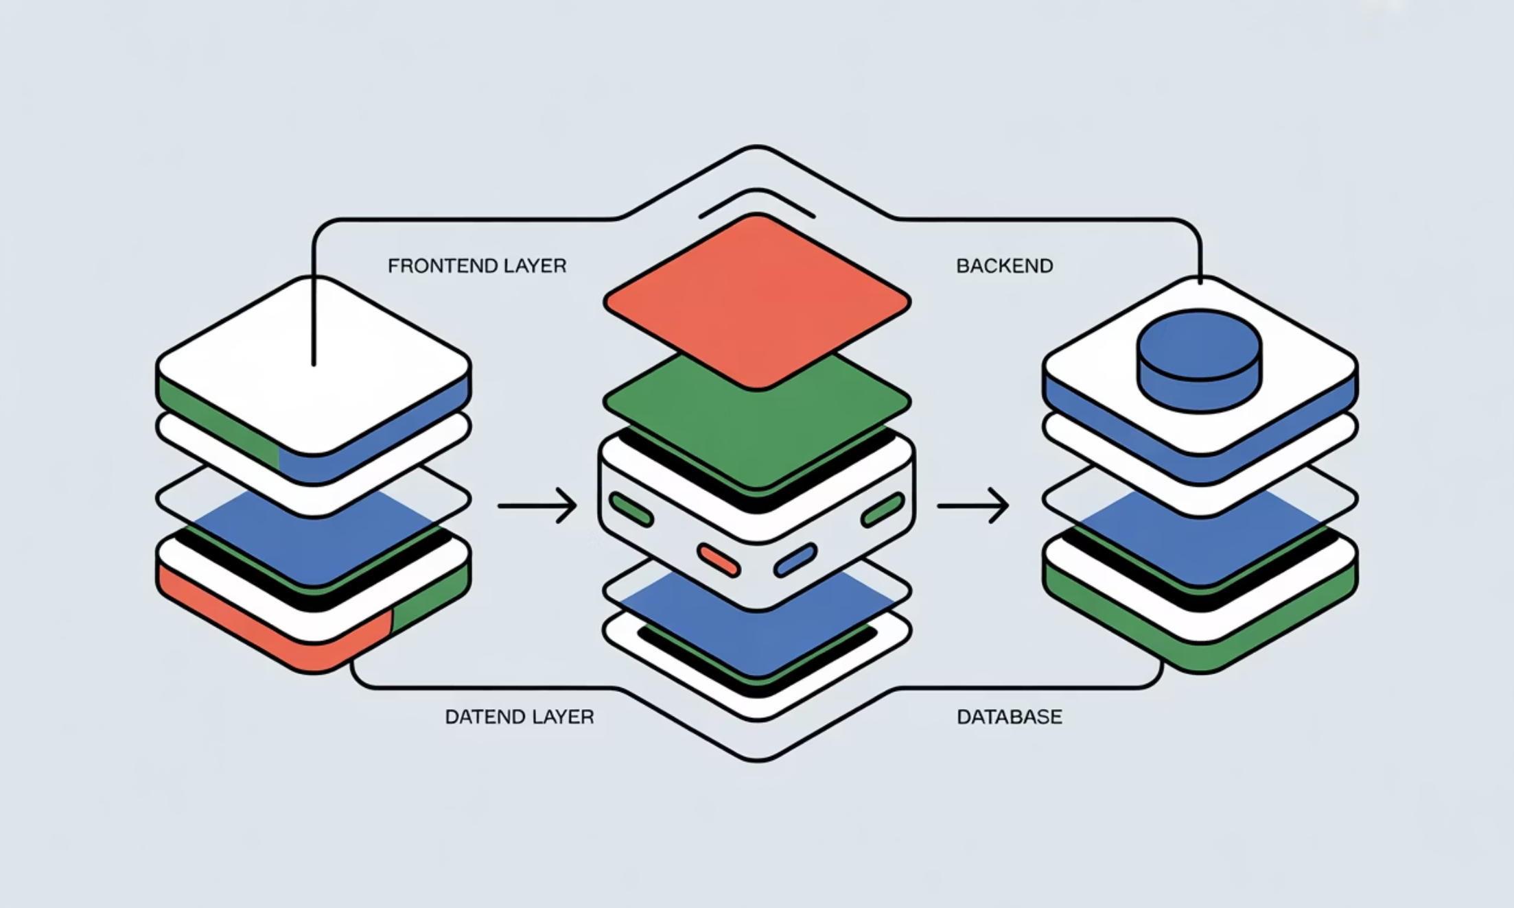
Architecture & Implementation
Frontend Architecture
Component-based React structure
Vite build tool for fast compilation
Axios for HTTP client operations
Environment-based API configuration
State management for UI components
Backend Architecture
Spring Boot application structure
REST controller endpoints
JPA repository pattern
Service layer for business logic
Configuration via application.yml

Slide 6

Docker Containerization
Dockerfile Creation
Define base image, copy application JAR, expose port 8080, and specify entry point for Spring Boot application
Image Building
Execute docker build command to create container image with all dependencies and application code bundled
Port Mapping
Map container port 8080 to host port 8081 using -p flag for external accessibility
Container Execution
Run docker container with proper environment variables and port bindings for production deployment

Slide 7

Deployment Process
Backend Deployment
Frontend Deployment
Build Docker image from Dockerfile
Tag image with appropriate version
Run container with port mapping
Verify service availability on port 8081
Test API endpoints using curl or Postman
Configure environment variables for API base URL
Build production bundle using Vite
Push code to GitHub repository
Connect repository to Vercel project
Deploy and verify production URL
Important: Ensure environment variables are correctly configured in Vercel dashboard to point to production backend API

Slide 8
Common Errors & Solutions
500 Internal Server Error
CORS Issues
Cause: Backend application crashes or unhandled exceptions
Cause: Frontend and backend running on different domains/ports
Resolution: Check server logs, validate request payload format, ensure database connections are active
Resolution: Configure @CrossOrigin annotation on Spring controllers or implement CORS filter
Port Binding Errors
Vercel Build Errors
Cause: Port 8081 already in use by another process
Cause: Missing output directory configuration
Resolution: Kill existing process or choose alternative port number for container mapping
Resolution: Specify build output directory in Vercel project settings to match Vite configuration

Slide 9
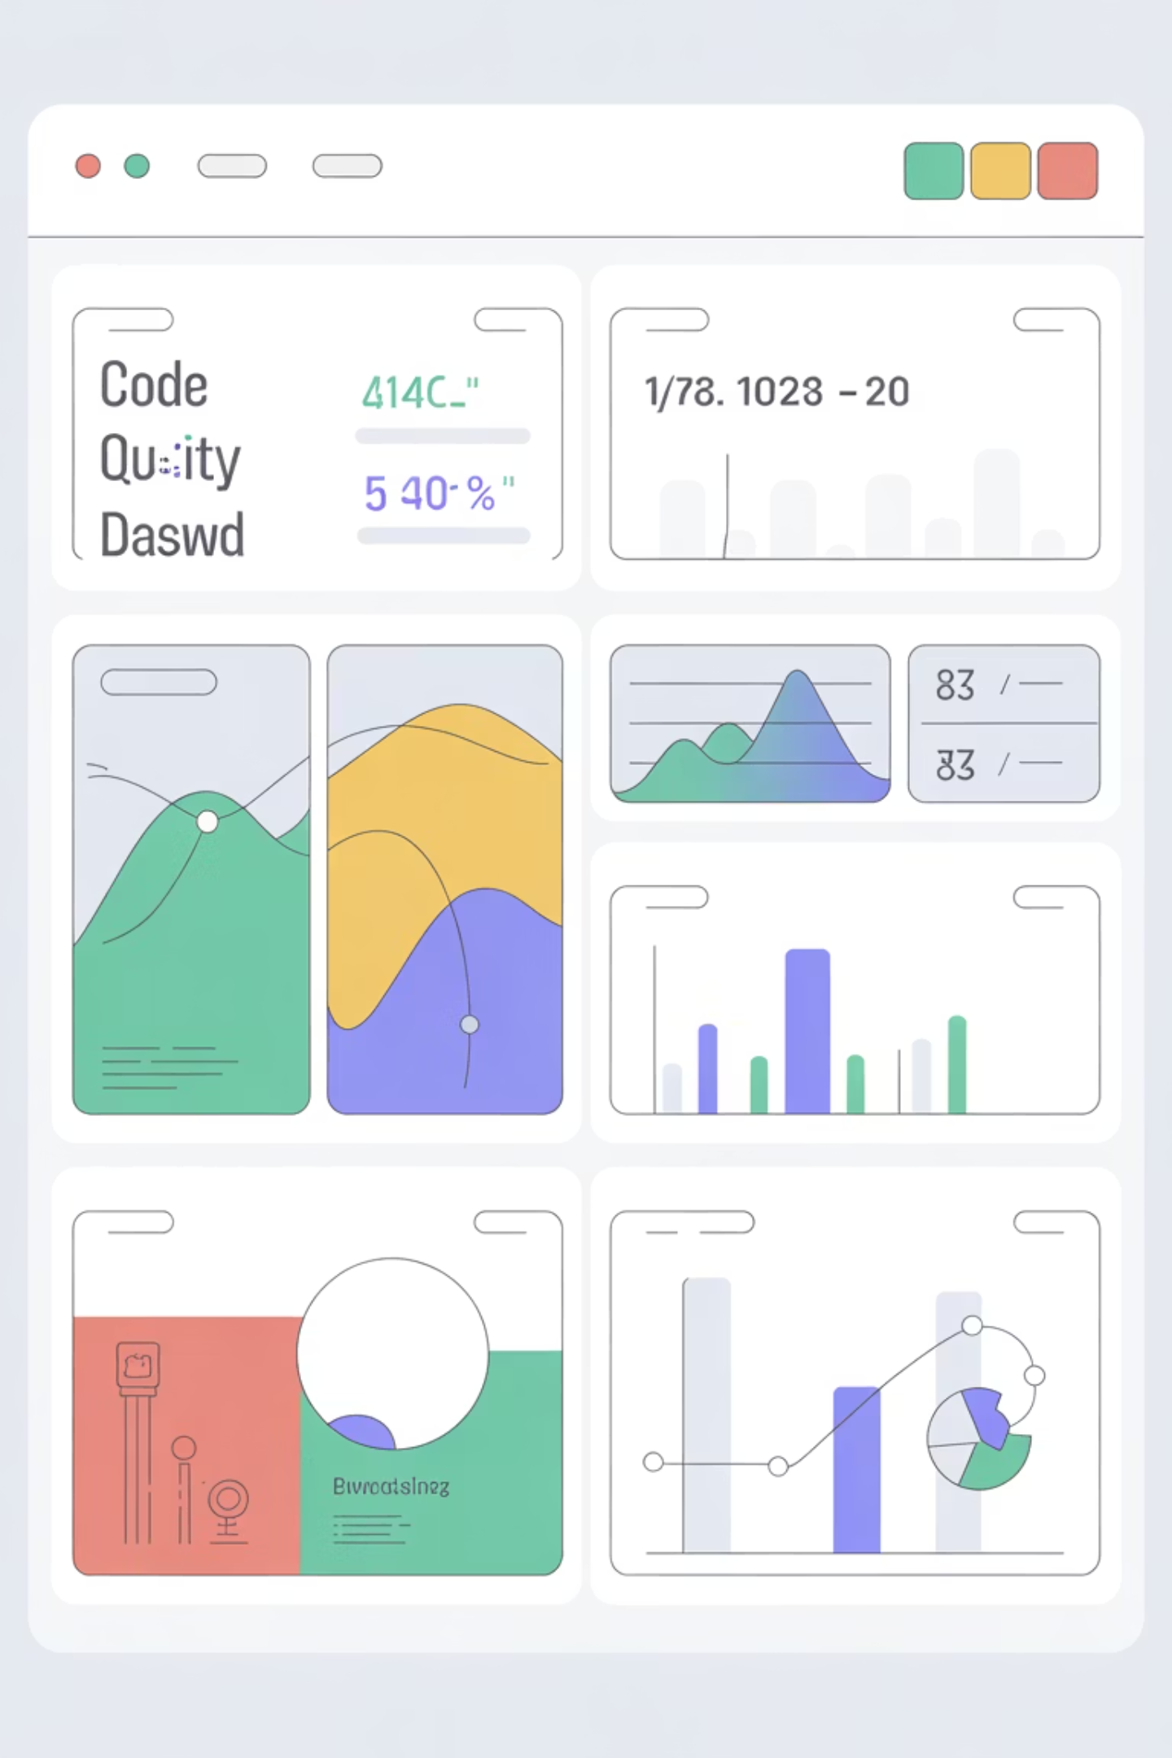
Testing & Code Quality
SonarQube Analysis
Challenge: Coverage
Integrated SonarQube for automated code quality analysis, identifying bugs, code smells, and security vulnerabilities. Quality gates enforce minimum standards before deployment.
Initial analysis showed 0% test coverage due to missing unit tests. This triggered Quality Gate failure in SonarQube.
Resolution Path
Add JUnit tests for service layer
Implement integration tests
Mock repository dependencies
Target 70%+ coverage for production

Slide 10
Results & Future Roadmap
✓ Successfully Deployed
✓ API Communication
✓ Production Ready
Full-stack application running with Dockerized backend and Vercel-hosted frontend
End-to-end integration achieved with proper error handling and response parsing
Environment-based configuration allows seamless switching between development and production
Future Enhancements
Authentication System
JWT-based login with secure token management and session handling
Role-Based Access Control
Granular permissions for different user types (admin, manager, staff)
Enhanced UI/UX
Modern design system with responsive components and accessibility features
CI/CD Pipeline
Automated testing, building, and deployment with GitHub Actions integration
Comprehensive Testing
Unit tests, integration tests, and end-to-end testing with Selenium

